Slide 1
Neuseeland
von Peter Kynast

Slide 2
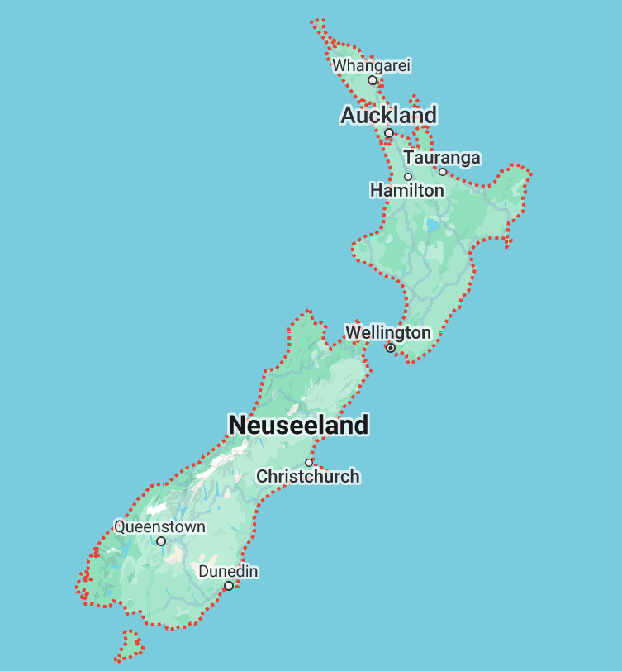
Rotorua

Slide 3
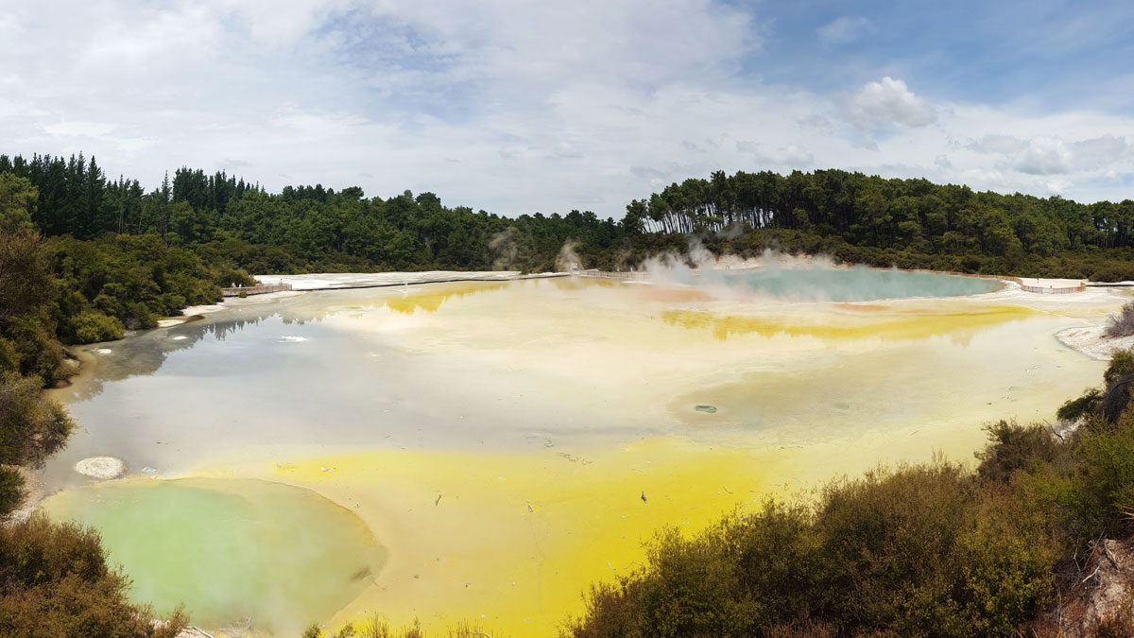
Rotorua - Wai-O-Tapu - Champagne Pool 1

Slide 4
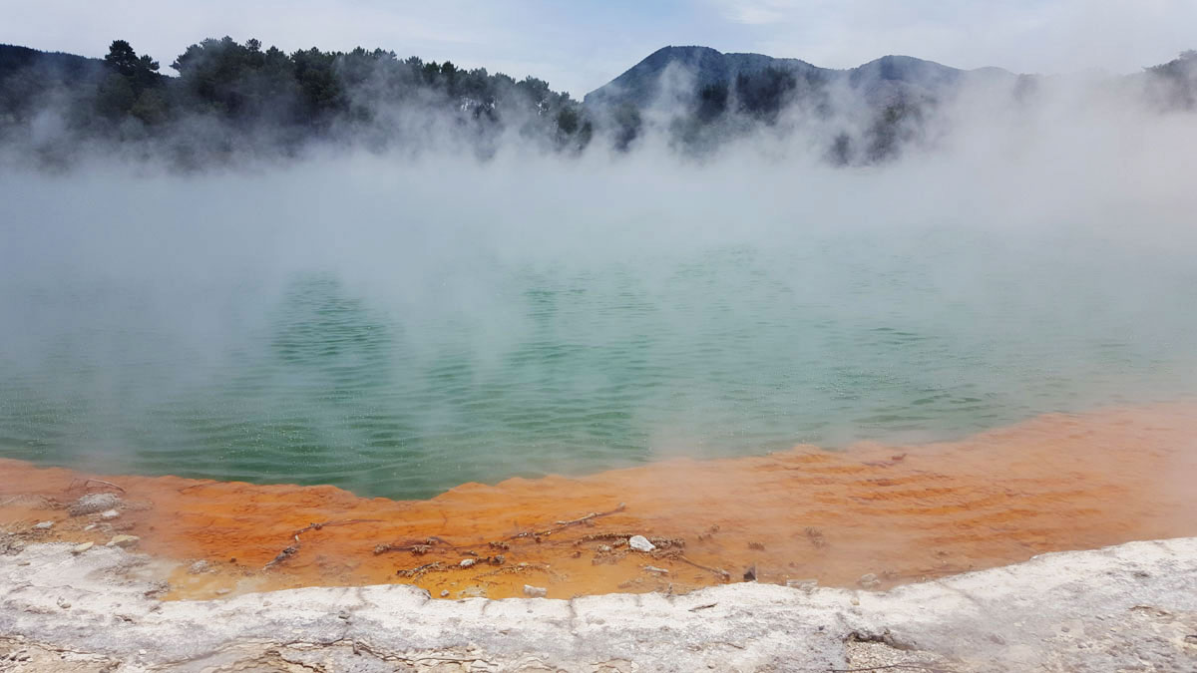
Rotorua - Wai-O-Tapu - Champagne Pool 2

Slide 5
Tongariro

Slide 6
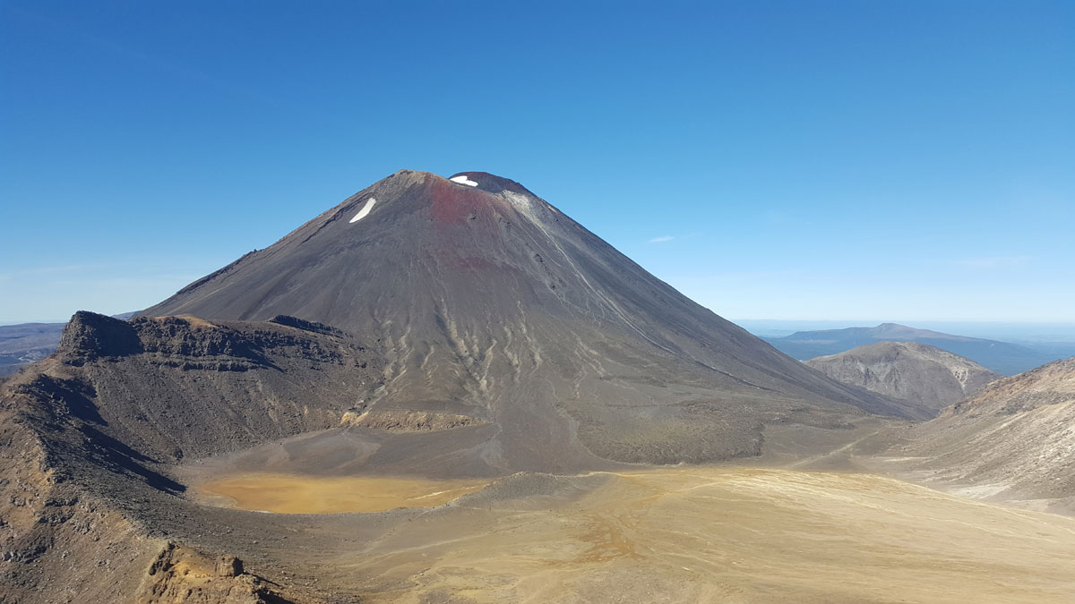
Tongariro - Mount Ngauruhoe

Slide 7
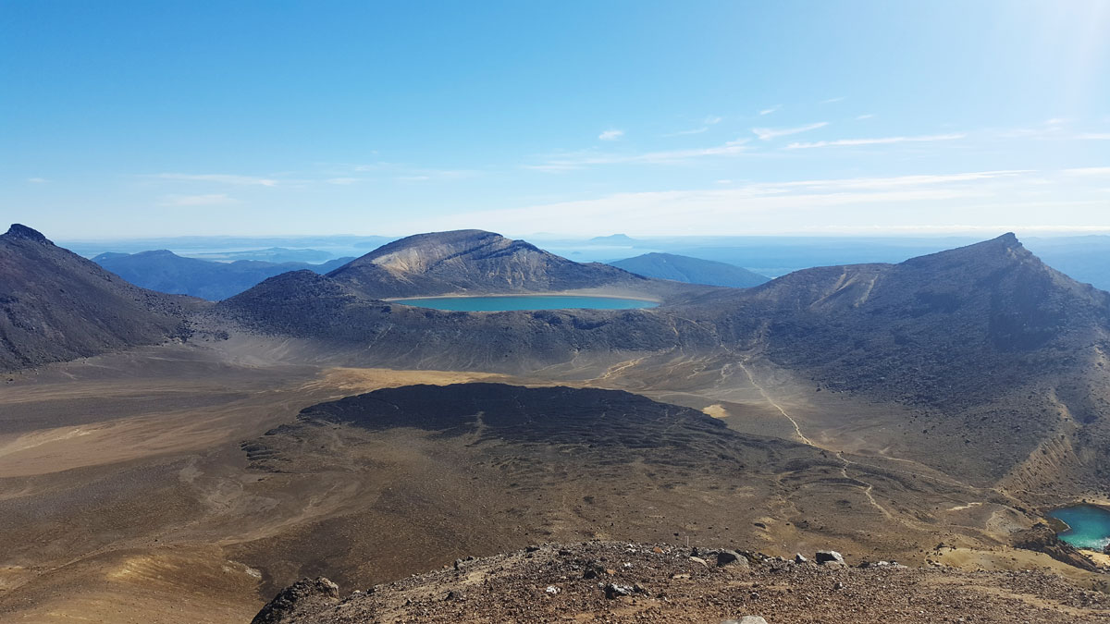
Tongariro - Blick vom Roten Krater

Slide 8
Coromandel

Slide 9
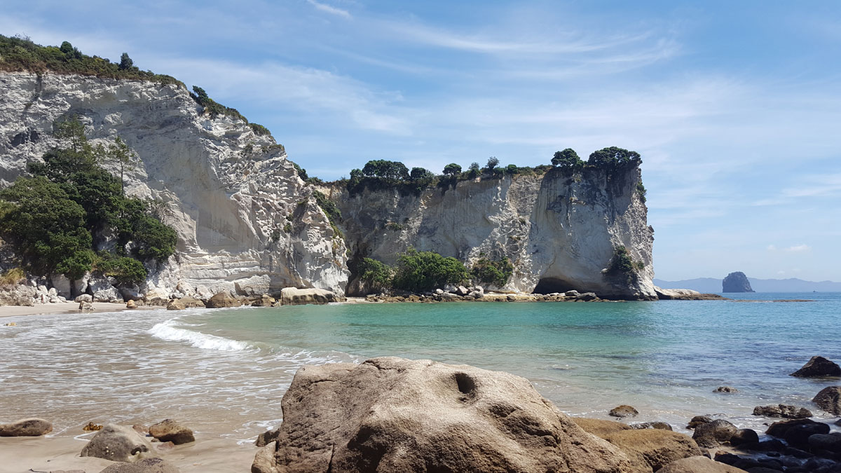
Coromandel - Hahei - Stingray Beach

Slide 10
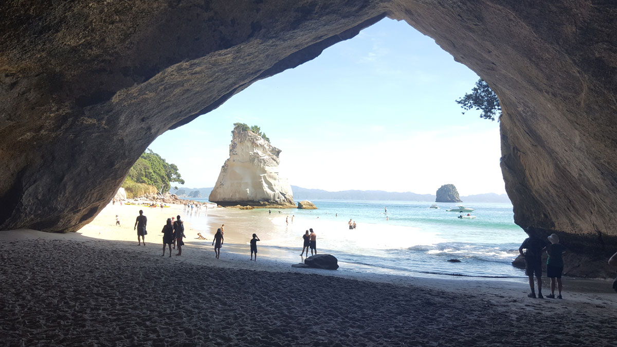
Coromandel - Hahei - Cathedral Cove + Te Hoho Rock

Slide 11
Marlborough Sounds

Slide 12
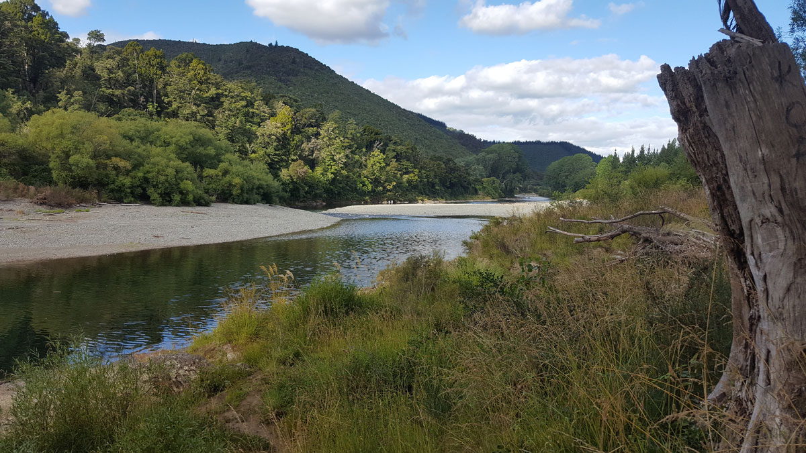
Marlborough Sounds - Rai Valley

Slide 13
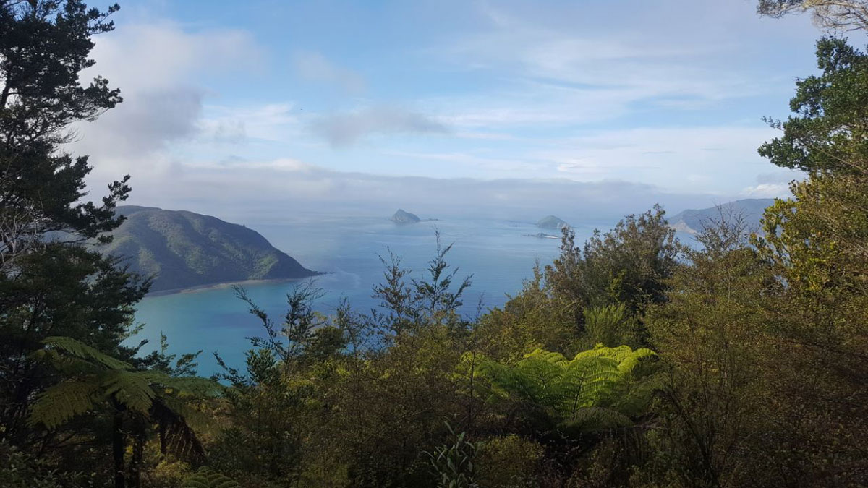
Marlborough Sounds - Okiwi Bay

Slide 14
Nationalpark Abel Tasman

Slide 15
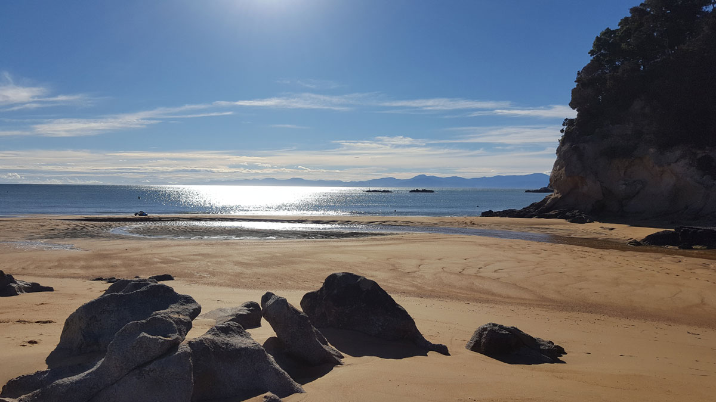
Abel Tasman Nationalpark - Kaiteriteri

Slide 16
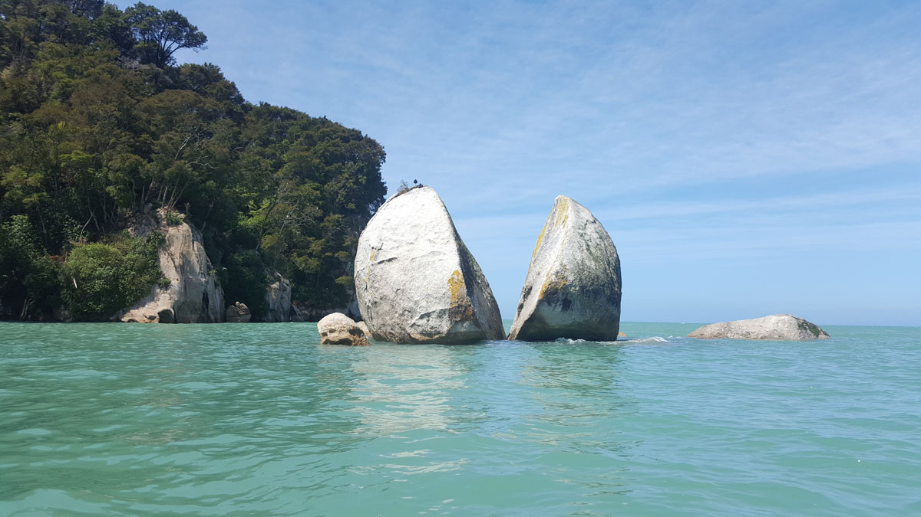
Abel Tasman Nationalpark - Split Apple Rock

Slide 17
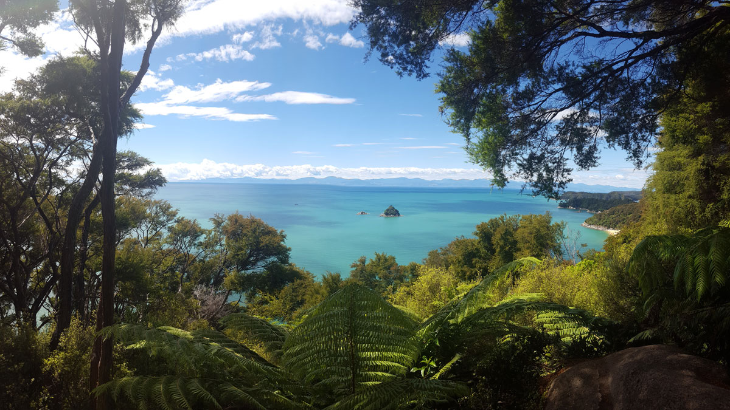
Abel Tasman Nationalpark - Pinnacle Island

Slide 18
Farewill Spit

Slide 19
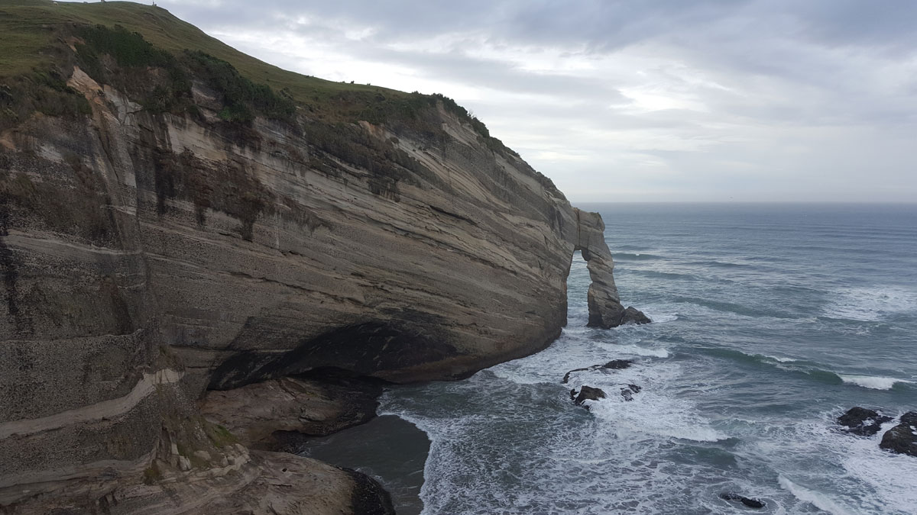
Farewell Spit - Cape Farewell

Slide 20
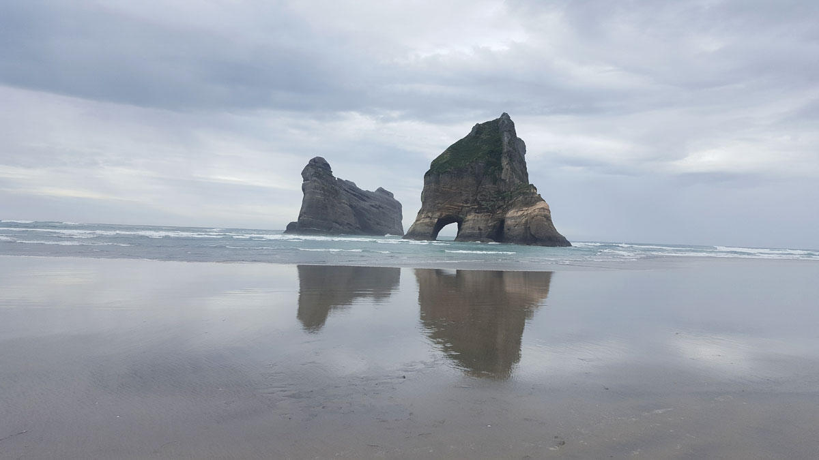
Farewell Spit - Wharariki Beach 1

Slide 21
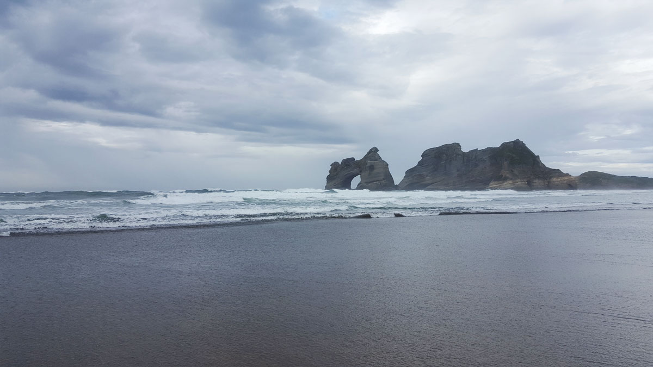
Farewell Spit - Wharariki Beach 2

